Slide 1

Experiment 6: Automatic Trash Can
Navarro, Rod Geryk C.
CPE160P - 4– A1

Slide 2
OBJECTIVES
To be able to demonstrate how an automatic trash can works.
2. To be able to apply embedded system in maintaining a trash can not to overflow.
3. To be able to demonstrate how the stepper motor will close the cover once the trash can is full, and the servo motor will press down the trash inside the trash bin.
4. To be able to apply what you have learned in Microprocessor and Logic Circuits and Switching Theory.
5. To be able to apply embedded system in a simple handshaking using Arduino Kit.

Slide 3
MATERIALS
Arduino Kit
Ultrasonic sensor
2 Servo motor
Breadboard
Cardboard
Capo
Arduino Uno
Laptop

Slide 4
PROCEDURE
Create a working Automated Trash Can using Arduino.
To demonstrate a working Ultrasonic Sensor and Servo using Arduino.
Debug the code

Slide 5
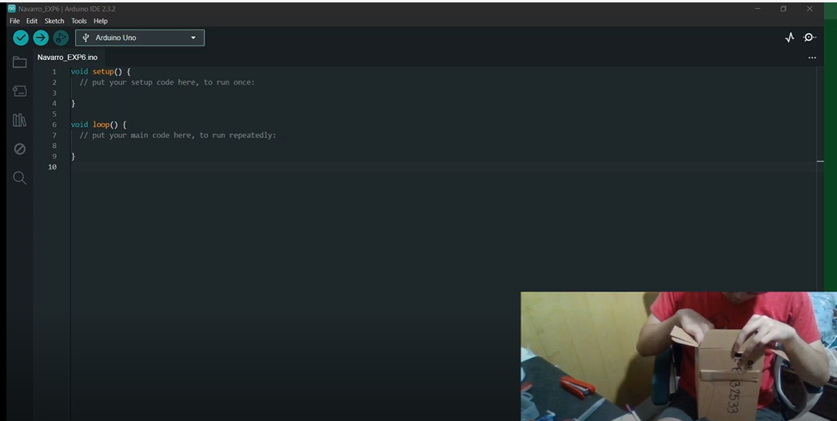
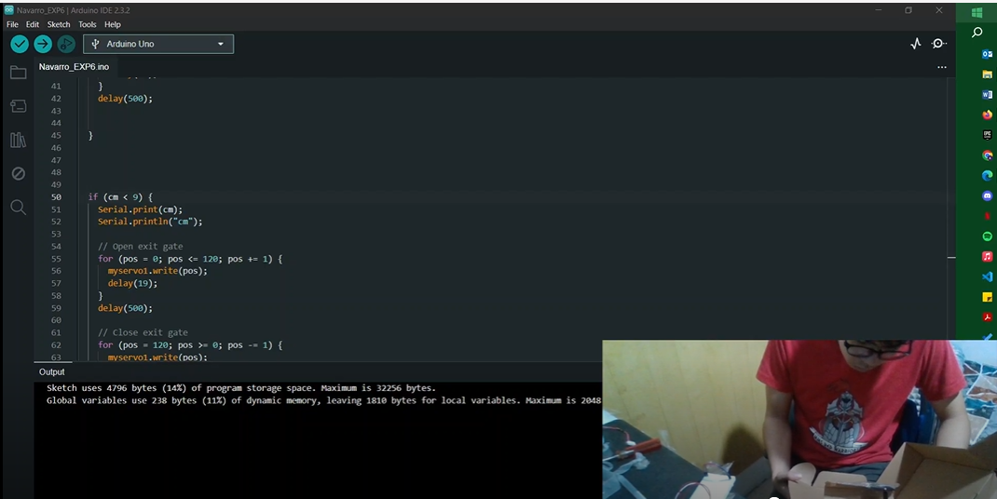
PROCEDURE

Slide 6
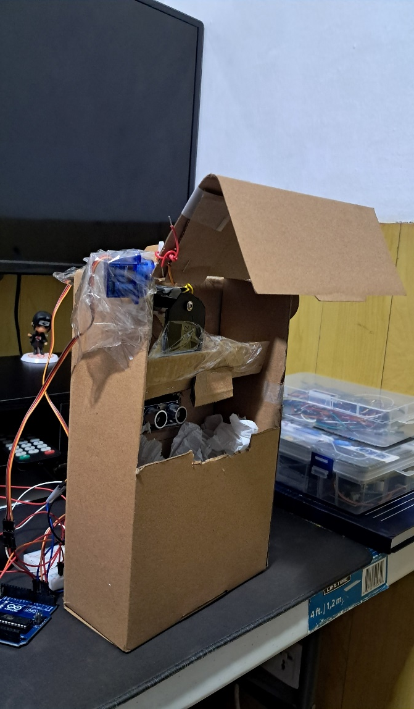
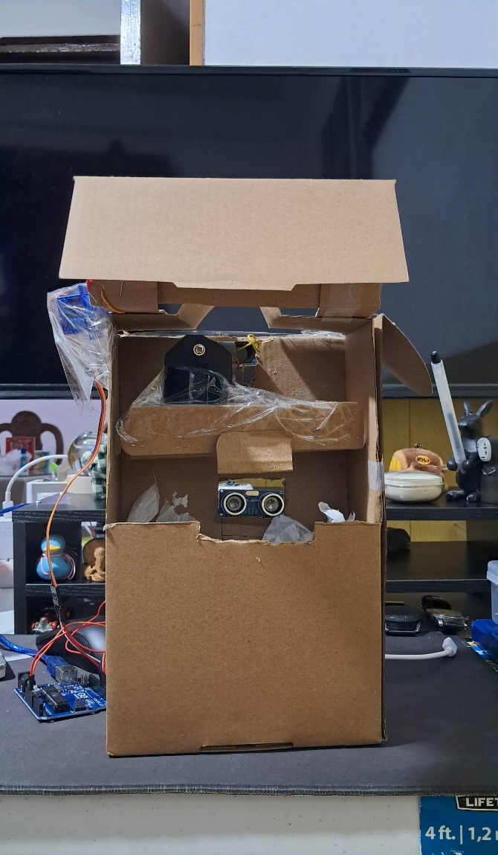
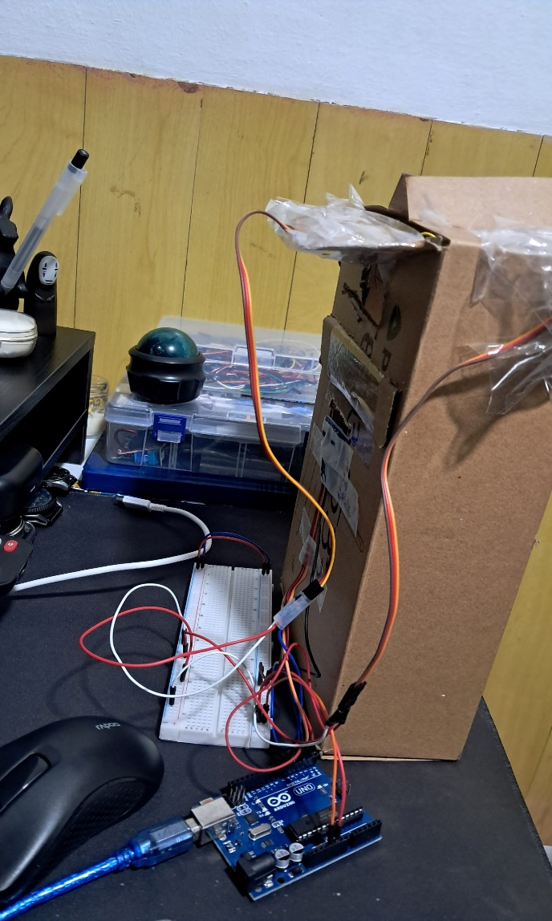
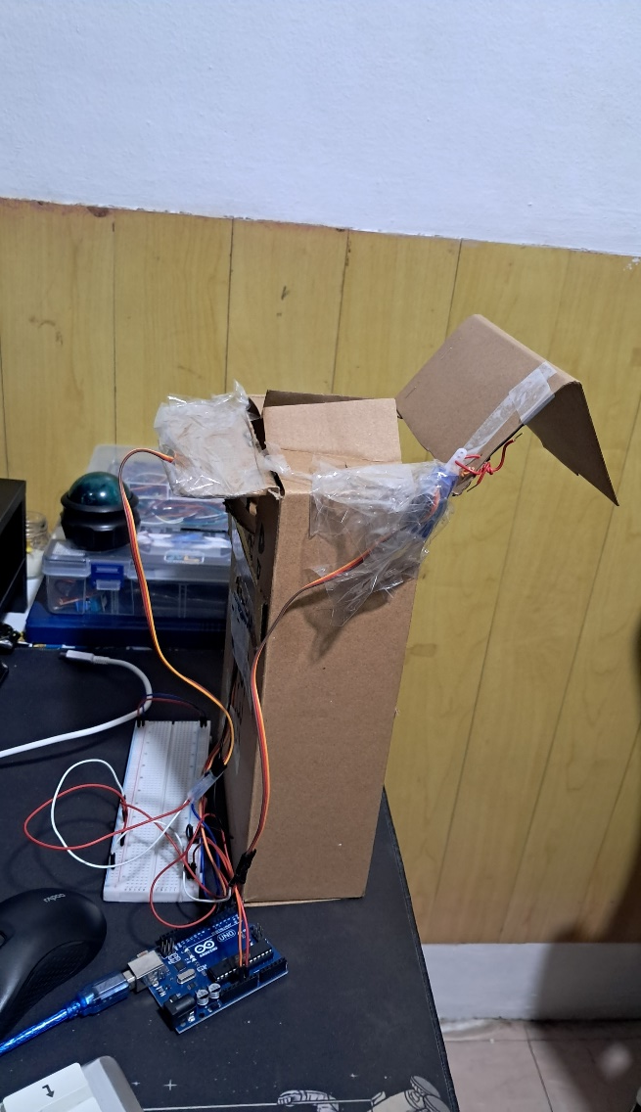
Final Output

Slide 7
THANK YOU!

